Slide 1

FILE HANDLING
(Part-II)
By:- Omaima Kamran
Roll No. 21/521
B.Sc. Physical Sciences with Computer Science
Maharaja Agrasen College
University of Delhi
Assigned by Professor Latesh Kanoujia

Slide 2
Recap…
A file is a document or data stored on a permanent storage device which can be read, written or re-written according to requirement.
CSV Files
Text Files
Types of Files
Binary Files
Comma Separated Values
Stream of ASCII or Unicode charecters
Might be images, videos, etc
Not readable by humans,
only interpreted by computers
*Ensure that text/binary file is saved in same folder as the python file

Slide 3

Recap…
File handling enables us to make programmes that are persistent, i.e., they store at least some of their data in permanent storage.
In other words, they are not transient. They are not executed in volatile memory (RAM).
Buffer is an area in memory where data is temporarily stored before being written to a file.
flush() function is used to force transfer data from buffer to file

Slide 4
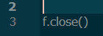
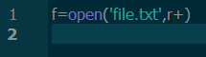
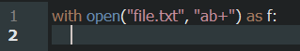
FILE OPERATIONS
1.
3.
5.
Opening a file
Writing to a file
Closing a file
If file exists, overwrites on file
If file does not exist, it is created for reading and writing
Open method
Syntax:-
With statement
Python automatically closes file object when file handle is assigned to some other data type .
2.
Reading a file
4.
Appending to a file
If file does not exist, error is raised
Without erasing previous content of file; content is added to the end of it

Slide 5
File modes
Mode | Description | Additional Notes
r | Opens a file for reading only | Default mode
rb | Opens a file for reading only in binary format | Pointer at beginning
r+ | Opens file for both reading and writing | If file does not exist, FileNotFoundError is raised.
rb+ | Opens file for both reading and writing in binary format
w | Opens file for writing only Overwrites the file if it exists. | Creates new file for reading. and writing if file does not exist
wb | Opens file for writing only in binary format
w+ | Opens file for both writing and reading | Difference between r+ and w+ is that if file does not
wb+ | Opens file for both writing and reading in binary format | exist, r+ raises error, whereas w+ creates a file for reading and writing
a | Opens file for appending | If file does not exist, new file is created for writing
ab | Opens binary file for appending | Pointer is at end of file
a+ | Opens file for both appending and reading | If file does not exist, new file is created for reading
ab+ | Opens binary file for both appending and reading | and writing

Slide 6

1. Reading from a file
read() method: Reads entire data from file, from cursor uptill end of file
read(n) method: reads ‘n’ charecters from a file
readline() method: reads only one line from the file, until end of line character
readlines() method: Returns list of strings, each string being a line in the file

Slide 7

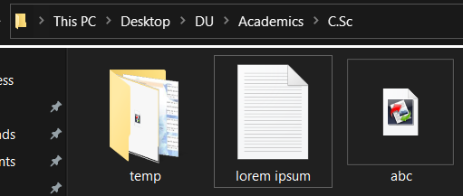
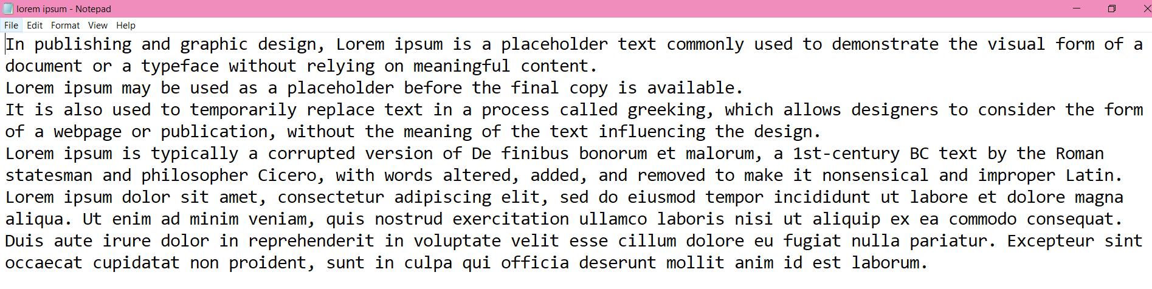
WORKING WITH BINARY FILES
Txt file is saved in same folder as python file
Initial contents of text file

Slide 8

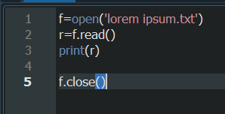
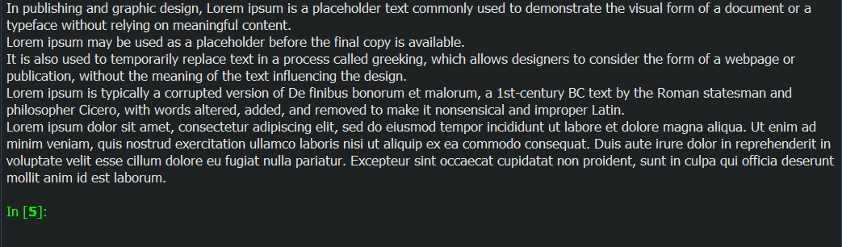
read() method
Code
Output

Slide 9
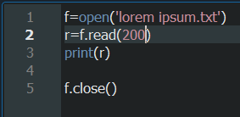
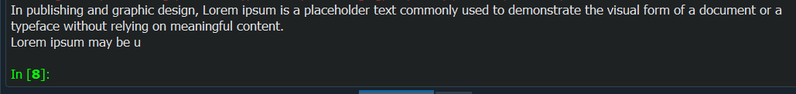
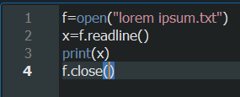
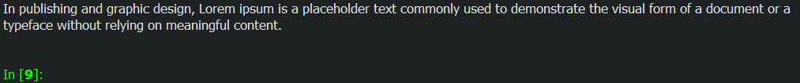
read(n) method
Code
Output
readline() method
Code
Output

Slide 10

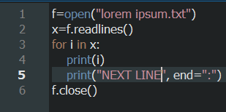
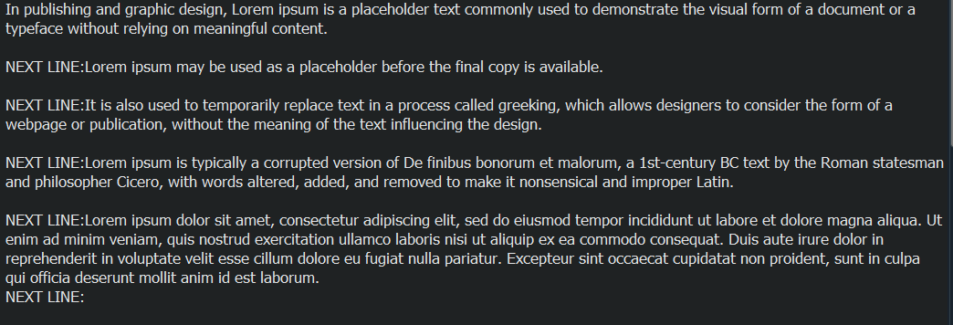
readlines() method
Code
Output

Slide 11
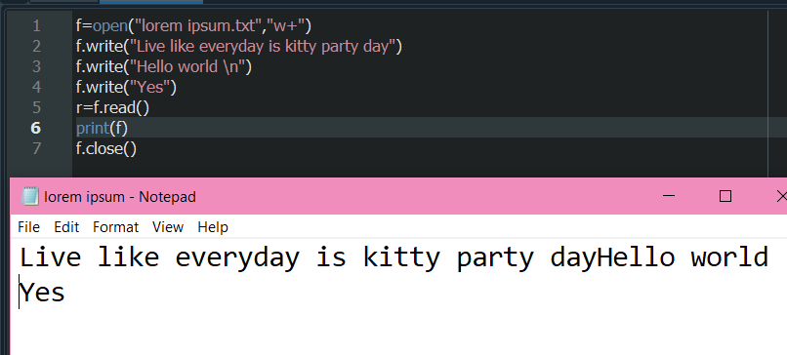
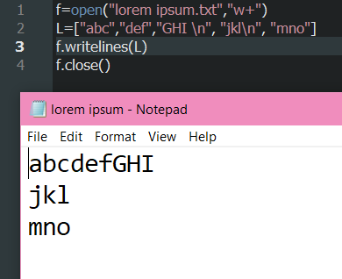
2. Writing to a file
write(string) method: Takes string as parameter and writes it in file
b) writelines(sequence_of_lines) method : Takes list of strings as parameter and adds to file
Output
Code
Code
Output
Output

Slide 12
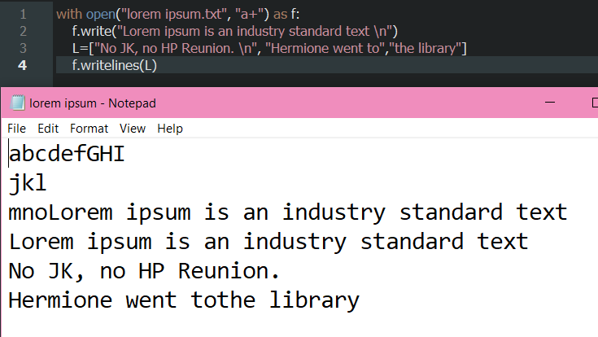
3. APPENDING to a file
Code
Output

Slide 13

BINARY FILES
Pickle Module
Random Access in Files
Dump
Load
Tell Function
Seek Function

Slide 14

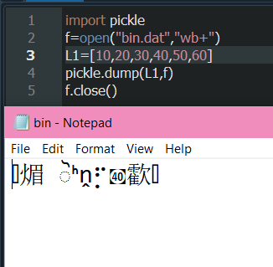
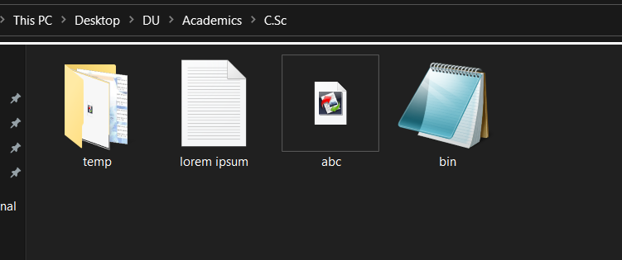
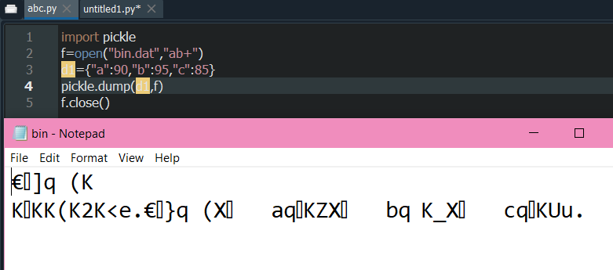
Using pickle module to dump(write into) binary file
Code
Output
Binary file has been created in folder
Passing dictionary to Binary file
Code
Output

Slide 15
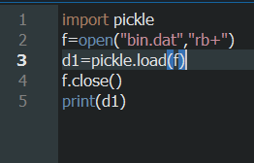
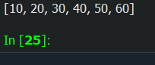
Using Pickle module to load (read from) binary file
Code
Output

Slide 16
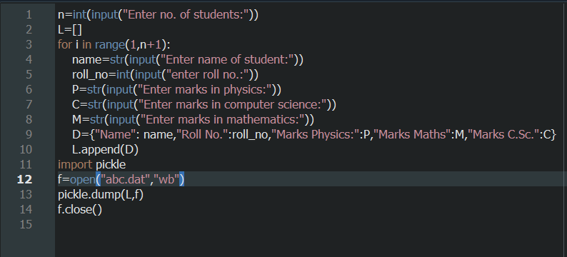
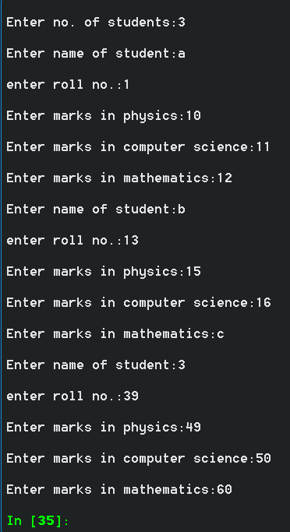
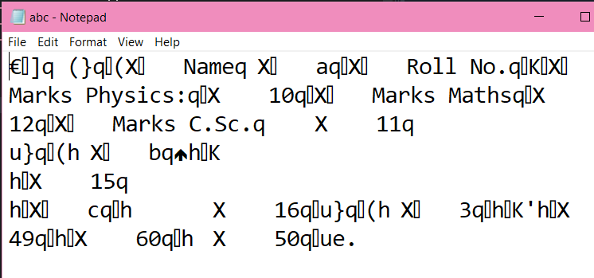
APPLICATION OF BINARY FILES:
To store records of students
Code
Output
Output in console

Slide 17
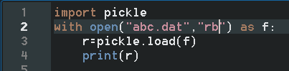
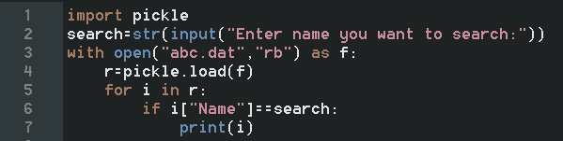
APPLICATION OF BINARY FILES:
To search records
Reading entire binary file
Code
Output
Searching particular record in binary file
Code
Output

Slide 18
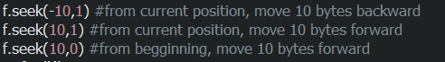
Random Access in Files
seek() function: Used to change position of file handle to a given specific position.
Default value is 0
0:Beginning of file.
1:Current position
2:End of file
tell() function: Returns current position of the file read/write pointer within the file

Slide 19

Therefore we learnt…
Importance of file handling
Opening, reading, writing to and appending to text files
Working with binary files

Slide 20


THANK YOU

